Slide 1
ACID Property in DBMS

Slide 2
ACID Property
A transaction is a single logical unit of work which accesses and possibly modifies the contents of a database
Transactions access data using read and write operations
In order to maintain consistency in a database, before and after the transaction, certain properties are followed
These are called ACID properties
ACID in DBMS stands for
Atomicity
Consistency
Isolation
Durability

Slide 3
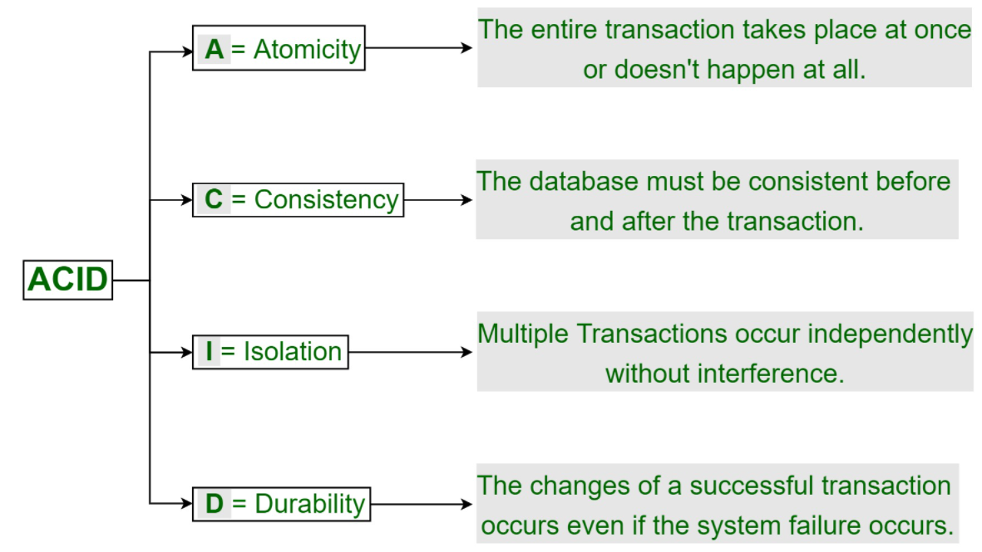

Slide 4
Atomicity
By this, we mean that either the entire transaction takes place at once or doesn’t happen at all
There is no midway i.e. transactions do not occur partially
Each transaction is considered as one unit and either runs to completion or is not executed at all
It involves the following two operations
Abort: If a transaction aborts, changes made to database are not visible
Commit: If a transaction commits, changes made are visible
Atomicity is also known as the ‘All or nothing rule’

Slide 5
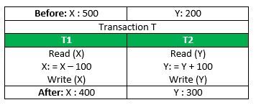
Example
Consider the following transaction T consisting of T1 and T2: Transfer of 100 from account X to account Y
If the transaction fails after completion of T1 but before completion of T2.( say, after write(X) but before write(Y)), then amount has been deducted from X but not added to Y
This results in an inconsistent database state
Therefore, the transaction must be executed in entirety in order to ensure correctness of database state.

Slide 6
Consistency
A transaction must transform the database from one consistent state to another state
It is the responsibility of both the DBMS and the application developers to ensure consistency
This means that integrity constraints must be maintained so that the database is consistent before and after the transaction
It refers to the correctness of a database

Slide 7
Example
Referring to the previous example
The total amount before and after the transaction must be maintained
Total before T occurs = 500 + 200 = 700 Total after T occurs = 400 + 300 = 700
Therefore, database is consistent
Inconsistency occurs in case T1 completes but T2 fails
As a result T is incomplete

Slide 8
Isolation
This property ensures that multiple transactions can occur concurrently without leading to the inconsistency of database state
Transactions occur independently without interference
Changes occurring in a particular transaction will not be visible to any other transaction until that particular change in that transaction is written to memory or has been committed
This property ensures that the execution of transactions concurrently will result in a state that is equivalent to a state achieved these were executed serially in some order

Slide 9
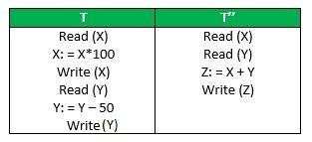
Example
Let X= 500, Y = 500. Consider two transactions T and T”
Suppose T has been executed till Read (Y) and then T’’ starts
As a result , interleaving of operations takes place due to which T’’ reads correct value of X but incorrect value of Y and sum computed by T’’: (X+Y = 50, 000+500=50, 500) is thus not consistent with the sum at end of transaction: T: (X+Y = 50, 000 + 450 = 50, 450) This results in database inconsistency, due to a loss of 50 units
Hence, transactions must take place in isolation and changes should be visible only after they have been made to the main memory

Slide 10
Durability
This property ensures that once the transaction has completed execution
The updates and modifications to the database are stored in and written to disk and they persist even if a system failure occurs
These updates now become permanent and are stored in non-volatile memory
The effects of the transaction, thus, are never lost

Slide 11
Thank You

